Slide 1
SAP S/4 HANA Training- Financial Accounting
Mahesh Koletti and Sai Gopal KVP
Notes:
The below and following notes on the template slides are to guide you only. In your final presentation, you may delete these notes and add relevant notes if any.
Title slide:
Title – should not exceed beyond 3 lines, font size 30-34, Arial Bold
(Font size for the title of the PPT can vary between 30-34, Arial, Bold depending on the amount of text, however should not be smaller than 30 font size)
Name should not exceed beyond 1 line, Designation; font size to remain at 16, Arial normal
Please keep the title slide simple, just the logo, title and name and designation to appear. No other graphic elements or any design, photograph, image can be added to this slide, alignment to remain the same

Slide 2
Agenda

Slide 3
High Level Overview
General Ledger- Master Data and Data models
Ledger and Currency Settings
Customer and Vendor
Banking

Slide 4
High Level Overview
NEW GL is mandatory for S4 Hana. Document splitting is optional
New Asset Accounting is mandatory
FSCM Credit management is the credit management application to be used. Classical FI-AR Credit management is no longer supported
Business partner is mandatory for S4 Hana Versions 1511, 1610 and 1709
Merge of GL and cost elements
Special purpose ledger remains untouched

Slide 5
High Level Overview
Users can choose between classical profit center accounting or new profit center accounting.
Users can choose account based copa or costing based copa or both
Project Systems and Investment management remains unaffected
Plan Data are stored in ACDOCP and Actual data are stored in ACDOCA
Universal journal can have upto 9999999 line item BSEG remains 999 line items document

Slide 6
High Level Overview
Bank account master data is maintained by application called Bank account management and directly maintained by end users. No need of FI12 tcode
Payment methods minor changes- SEPA, this feature is not available in ECC
No changes in dunning, special gl, lockbox, taxes, automatic payment process
Addition of interval in posting period to allow postings from controlling
BPC can be used for planning and consolidation
Document type can be maintained for controlling from FI document types along with number range and other planning functions

Slide 7
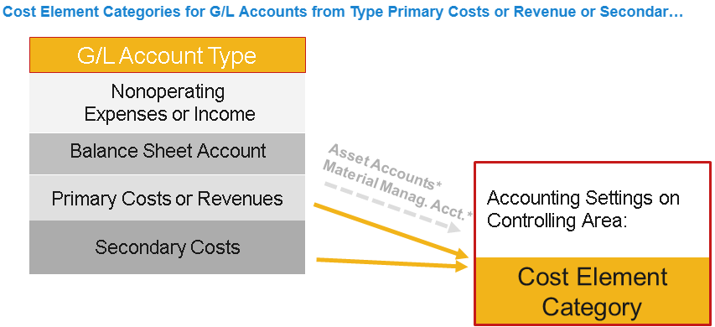
General Ledger- Master Data
When the G/L type primary costs or revenue is chosen, you can update account settings for the controlling area.
Line item display no longer required
The cost element category specifies which business transactions can be used with which cost element.
In SAP Accounting, a default account assignment can be defined using transaction OKB9 or through substitution rules only.
Default account assignments maintained in former cost element master data are migrated to transaction OKB9 as part of the migration process.

Slide 8
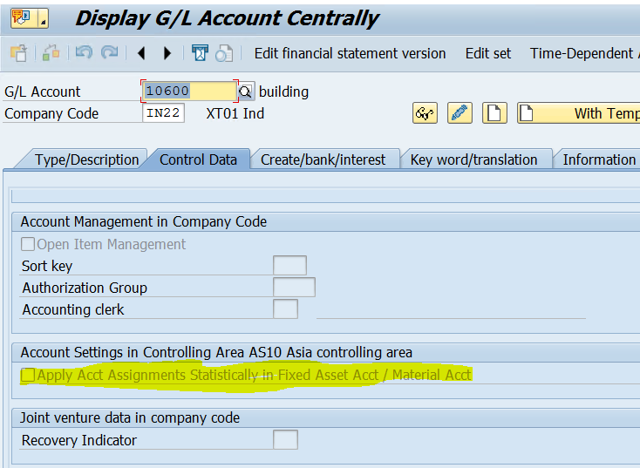
General Ledger- Statistical Cost Element
Background: Capital investments that do not have an asset under construction phase are usually capitalized directly in Asset Accounting. However, you may want to see that information in Management Accounting at the same time. For instance, you may want to manage plan values, budgets and commitments in order to carry out plan/actual comparisons. It is possible to post and track these transactions on statistical internal orders or WBS elements.
The following conditions are necessary for the statistical updating of orders or WBS elements: The CO object (investment order or WBS element) is entered in the asset master record as an investment account assignment (in the time-Origin).
The indicator for statistical updating of the order or WBS element is set in the definition of the transaction types used for asset transactions (indicator: Relevant to budget).

Slide 9
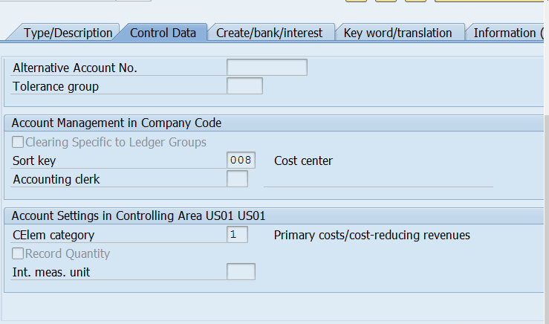
General Ledger- Master Data
The cost element aspect is captured and there is no default account assignment
Record Quantity is the new option given
Minor change in cost element category we have 90 used for statistical posting of Materials and Assets

Slide 10
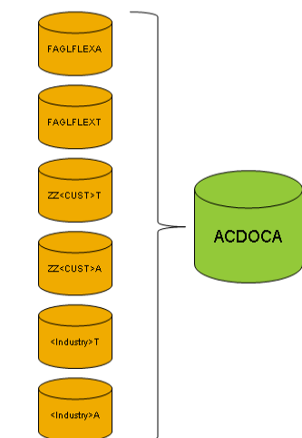
General Ledger- Master Data
Postings from outside SAP Finance (except AA) into SAP Finance use a standardized Accounting Interface, so the other Applications have not much to focus on the changed data structure and posting logic inside Finance.
BSEG summarization works and can be used as usual (SAP Note 2179270).
BSEG Stores Prima nota postings for FI related postings. Ledger related postings save in ACDOCA
BSEG is used for storing open items and clearing details, thus you can be quite aggressive with the summarization. ACDOCA stores the full detail that is needed for all components that base on ACDOCA (G/L, AA, ML, CO, PA).
The table BSEG should be summarized as far as possible and the table ACDOCA should be summarized as little as possible in order to enable reporting that is differentiated as possible in the table ACDOCA. The summarization in the table ACDOCA can, at most, be as large as that of the table BSEG, since line items in the table ACDOCA cannot be summarized further than the corresponding line items in the table BSEG.
Because the account-based CO-PA line items including the profitability segment number and the resolved characteristic vector are stored in the table ACDOCA, the same summarization settings are used for CO-PA profitability segment determination. You can, therefore, find these settings along with documentation and the existing summarization for costing-based CO-PA line items at Controlling → Profitability Analysis → Flows of Actual Values → Initial Values → Summarization
In the new General Ledger (G/L), data previously stored in FAGLFLEXA, FAGLFLEXT (carry forward) is now stored in the table ACDOCA.
Data of the new G/L industry tables for Public Sector and Joint Venture Accounting (FMGLFLEXA/T, PSGLFLEXA/T, JVGLFLEXA/T) is now stored in the table ACDOCA.
A compatibility view is provided for table FAGLFLEXA: FGLV_FAGLFLEXA. This compatibility view redirects select statements from FAGLFLEXA to ACDOCA.

Slide 11
General Ledger- Master Data
Customer data created new G/L tables ZZ<CUST>T, ZZ<CUST>A, which are now stored in the table ACDOCA.
Compatibility views for the New G/L industry tables are provided, V_<Industry>A, V_<Industry>T.
Compatibility views are provided for the customer created new G/L tables. The views are numbered sequentially: ZFGLV_GLTT_Cx (totals) and ZFGLV_GLSI_Cx (line items), where x is a number

Slide 12
General Ledger- Master Data
The cost element aspect is captured and there is no default account assignment
Record Quantity is the new option given
Minor change in cost element category we have 90 used for statistical posting of Materials and Assets

Slide 13
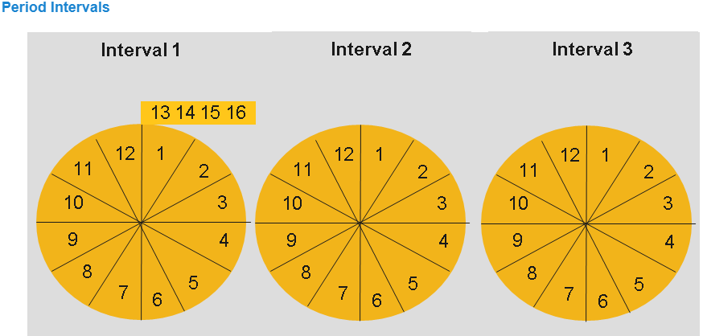
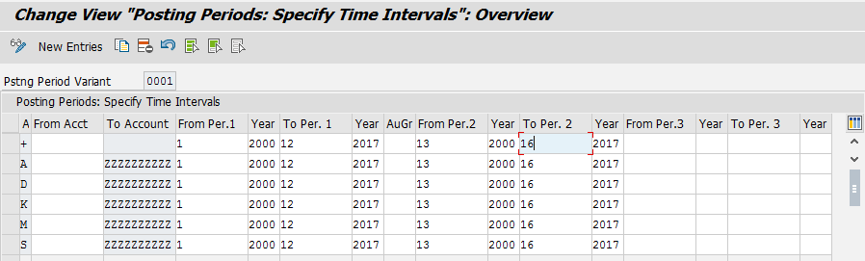
General Ledger- Posting periods
In transaction OB52, for each variant you can specify which posting periods are open for posting. You can choose period intervals 1 between and 3.
You can use period intervals 1 and 2 for all normal posting processes in regular and special periods.
For period interval 1, you can enter a group of authorized users. This means that for month-end or year-end closing, for example, you can open posting periods for specific users only.
You make the necessary authorization settings in the optional authorization object Accounting Document: Authorizations for posting periods (F_BKPF_BUP). We recommend using period interval 1 for special periods because authorizations can only be managed here.
Period interval 3 is used for postings from Controlling (CO) to Financial Accounting (FI). If you do not make an entry for period interval 3, the check on these postings is made against period intervals 1 and 2. If you make an entry for period interval 3, the check on these postings is only made against period interval 3. For each interval, you specify the lower and upper limits of the posting period as well as the fiscal year.

Slide 14
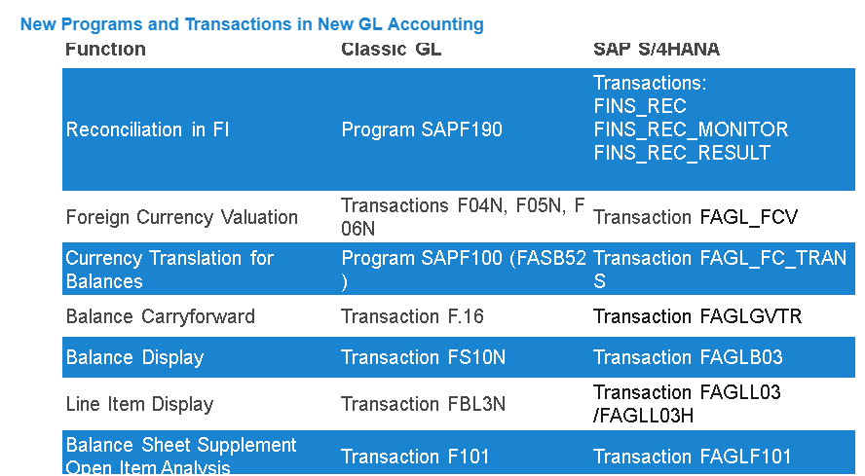
General Ledger- Transaction codes

Slide 15
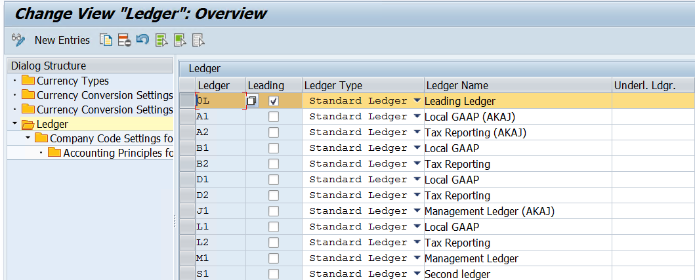
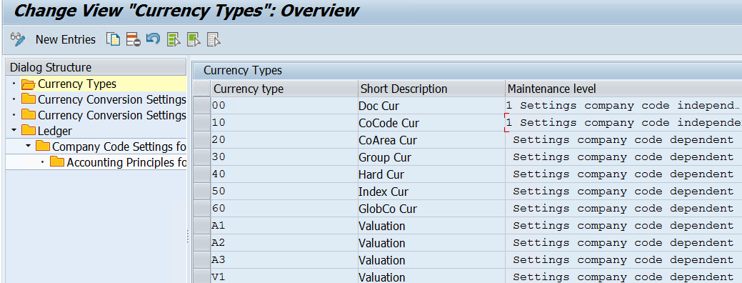
Ledger and Currency Settings
Center point for all the ledger, currency assignments, fiscal year variants and posting period variants for all company codes
This removes the need for OB22, though you can access but you cannot maintain
Consultants can also create extension ledger as many as they want.
SAP Provides currency type from 00 to 60
Users can define freely used currency and current model supports 8 such currency types in case of transfer pricing where you need valuation view for group valuation.”

Slide 16
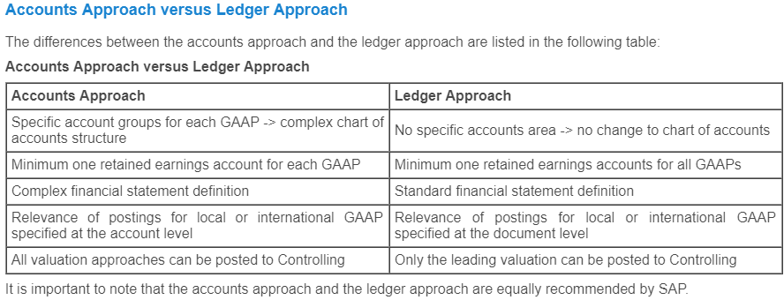
Ledger and Currency Settings- Ledger
In the new platform, SAP offers two approaches to manage your day to day accounting process:
Accounts Approach
Ledger Approach
Clients can choose either of approach as per their needs and both are equally supported by sap
There will be slight change in configuration between both.
Leading ledger and non leading ledger will be applicable for ledger approach.
Only leading ledger will be applicable for accounts approach
The approach will have impact on controlling, Asset accounting transactions. Most of the transactions based on leading ledger

Slide 17
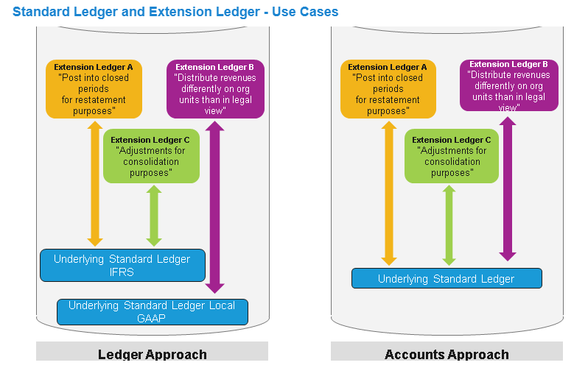
Ledger and Currency Settings- Extension Ledger
Extension ledgers are based on an underlying ledger. The underlying ledger can be leading and non leading ledger.
Only manual entries are posted in this ledger. Incase your posting periods are closed. You can still use extension ledger to make adjustment postings
An extension ledger is assigned to a standard ledger and inherits all journal entries of the standard ledger for reporting.
Postings made explicitly to an extension ledger are visible in that extension ledger but not in the underlying standard ledger.
An extension ledger stores delta values and points to another ledger - thus providing a flexible mechanism for adjustments and reporting.
Example for Extension ledger- management views on top of legal data (IFRS or Locale GAAP).
Besides creating a master record, Extension Ledgers do not need additional configuration.
Reporting on the extension ledger always includes the data of the underlying ledger.
Multiple extension ledgers can point to the same underlying ledger.

Slide 18
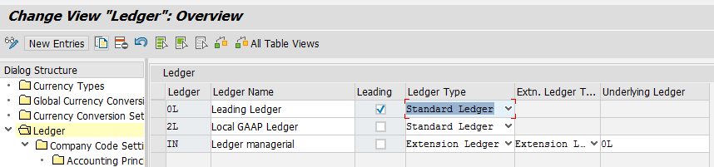
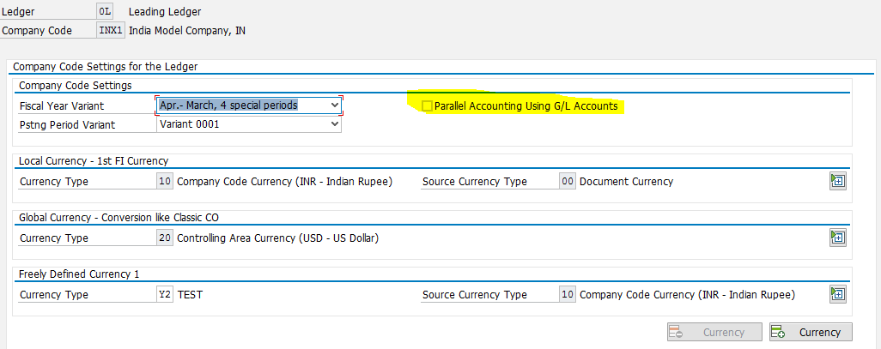
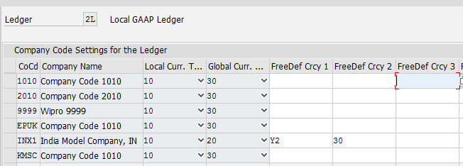
Ledger and Currency Settings
Accounts
Approach
Ledger
Approach

Slide 19
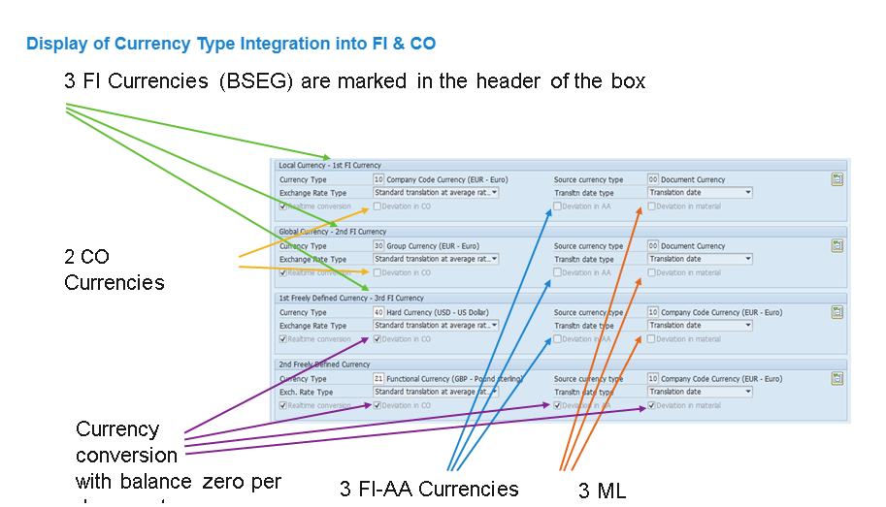
Ledger and Currency Settings
Generally SAP has limits on currencies that can be defined
FI – 3 Currencies
CO- 2 Currencies
Asset- 3 Currencies
ML- 3 Currencies
Any modification on above needs SAP intervention and possibility of SLO project

Slide 20
Ledger and Currency Settings
SAP Provides currency type from 00 to 60
Users can define freely used currency and current model supports 8 such currency types in case of transfer pricing where you need valuation view for group valuation.”

Slide 21
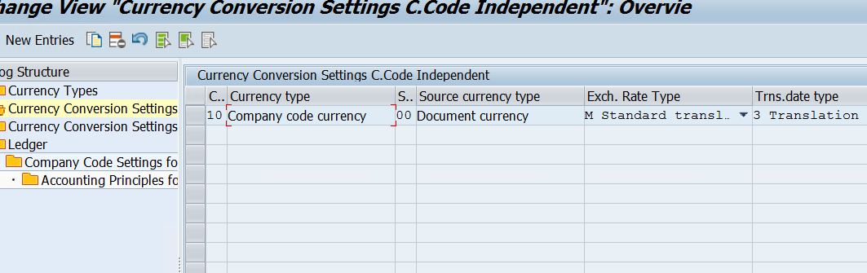
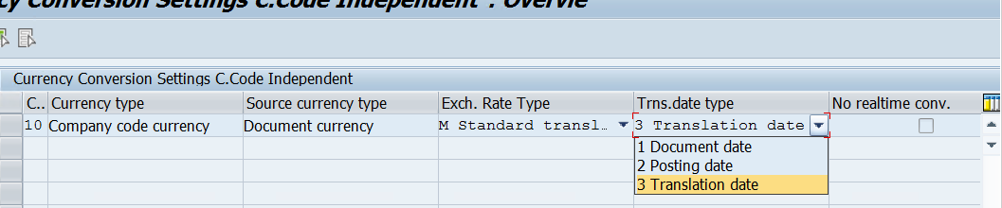
Ledger and Currency Settings
Currencies are assigned and the standard translation rates are defined over here.
The user can choose whether the translation type can be Document date, posting date or Translation Date.

Slide 22
Ledger and Currency Settings
Currencies are assigned and the standard translation rates are defined over here.
The user can choose whether the translation type can be Document date, posting date or Translation Date.

Slide 23
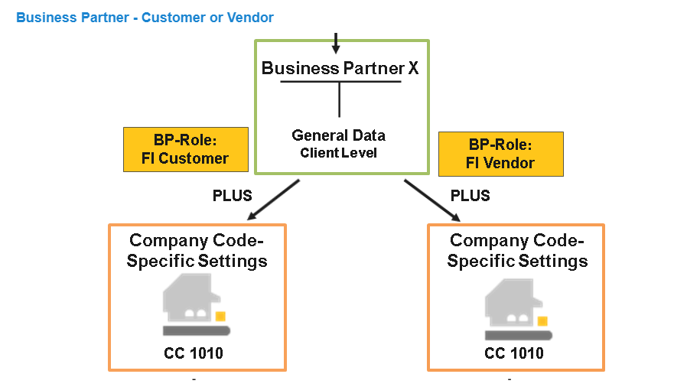
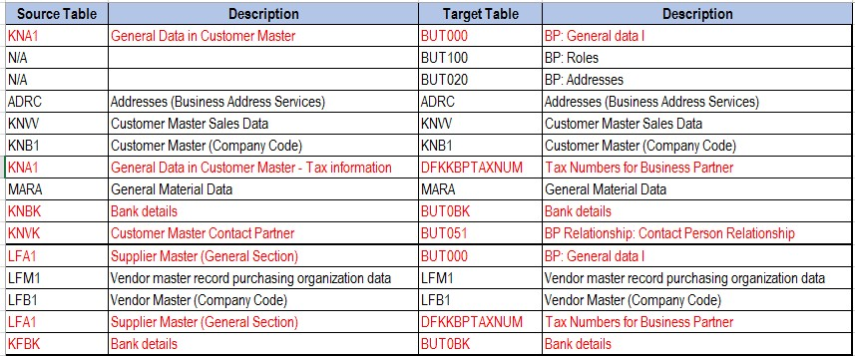
Business Partner
S/4 HANA, Business partner creation is mandatory to post customer and vendor transactions
Business partner can be a person, organization or group
Business Partner Role: A business partner role is used to classify a business partner in business terms. The roles you assign to a business partner reflect the functions it has and the business transactions in which it is likely to be involved.
Grouping: When you create the business partner you have to assign each business partner to a grouping. The grouping determines the business partner number (range).
Company Code Specific Settings (Business Partner Role: FI Customer)
Postings in Financial Accounting cannot be made to the customer account for a company code until company code specific settings have been created. These settings refer only to the relevant company code and include details, such as agreed payment conditions or reconciliation account.
Document attached contains the master data setup

Slide 24
Business Partner
S/4 HANA, Business partner creation is mandatory to post customer and vendor transactions
Business partner can be a person, organization or group
Business Partner Role: A business partner role is used to classify a business partner in business terms. The roles you assign to a business partner reflect the functions it has and the business transactions in which it is likely to be involved.
Grouping: When you create the business partner you have to assign each business partner to a grouping. The grouping determines the business partner number (range).
Company Code Specific Settings (Business Partner Role: FI Customer)
Postings in Financial Accounting cannot be made to the customer account for a company code until company code specific settings have been created. These settings refer only to the relevant company code and include details, such as agreed payment conditions or reconciliation account.
Document attached contains the master data setup

Slide 25
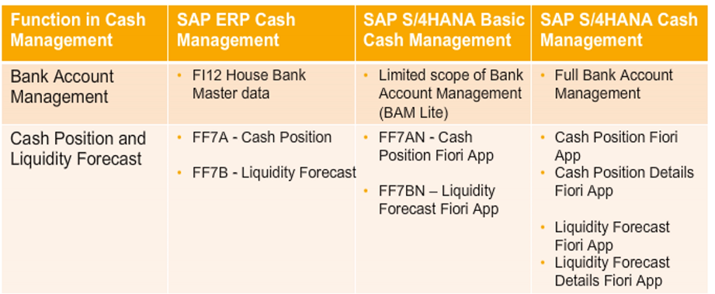
House Bank- Cash Management Basics
Customers can opt for Bank Account management lite or cash management full version. The difference between the two are mentioned below

Slide 26
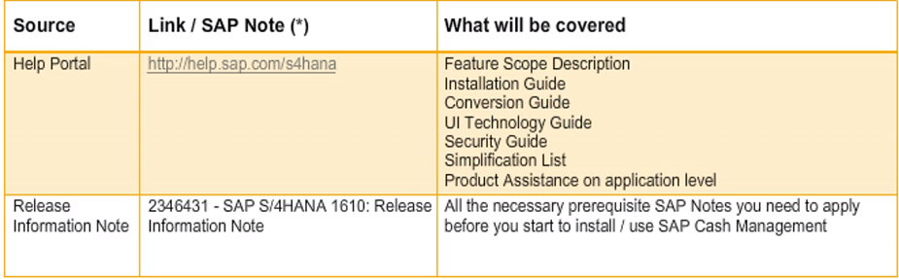
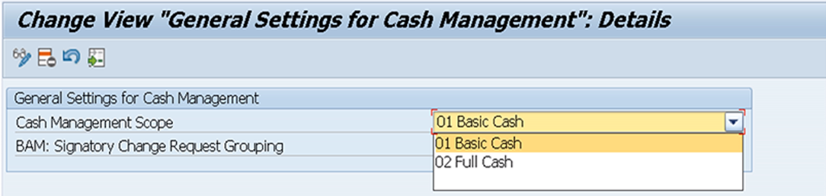
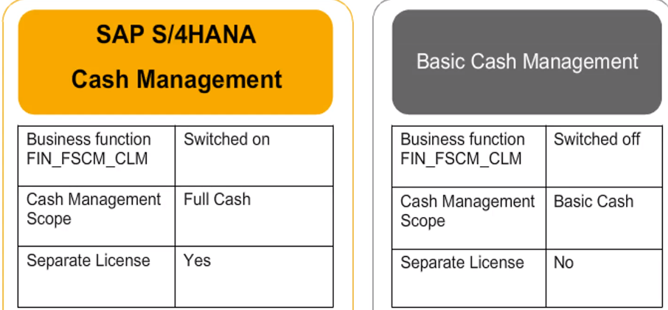
House Bank- Bank Account Lite
The basic configurations for Bank account lite are mentioned in the note and screen below are the main configuration
The business function FIN_FSCM_CLM will be active for full cash management and will be deactivated for BAM LITE version

Slide 27
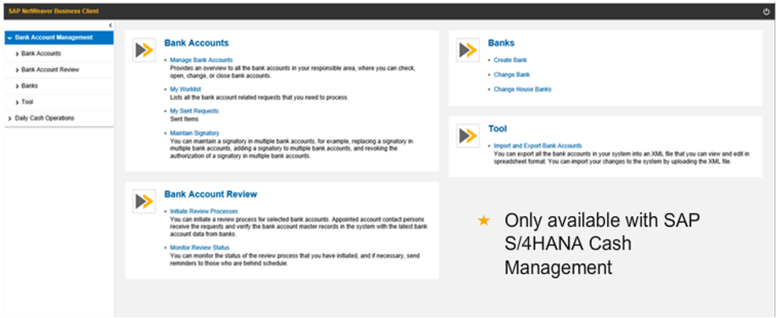
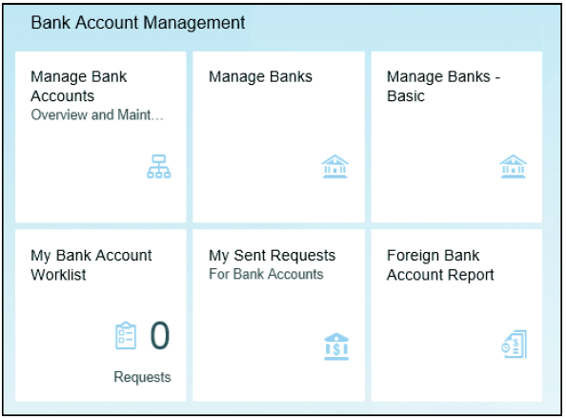
House Bank- Bank Account Lite
Basic Screen for BAM LITE
User can access via netweaver or Fiori Apps
The user can add house bank without need of IT colleagues

Slide 28
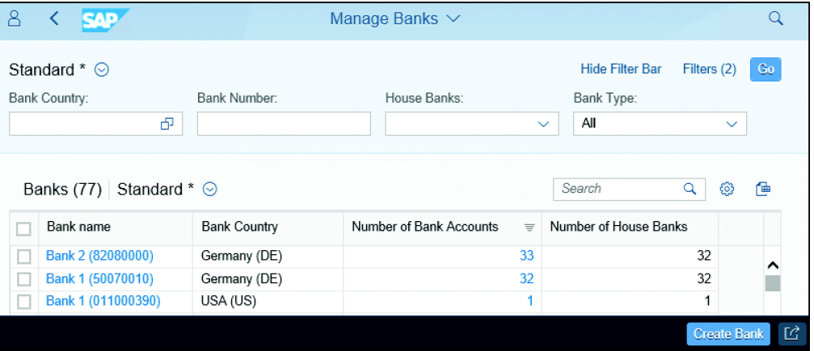
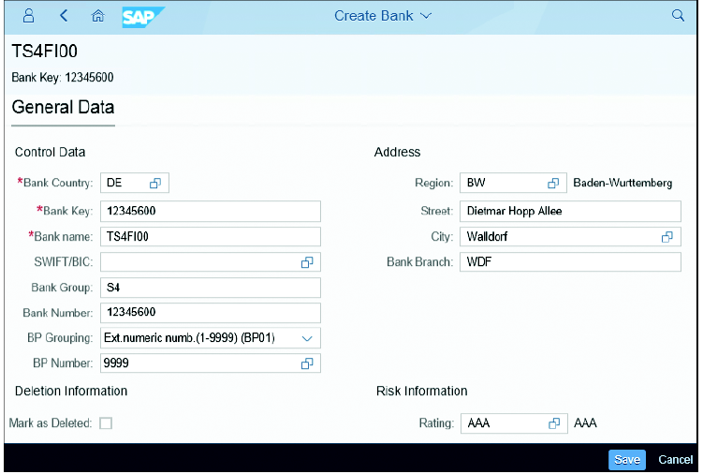
House Bank- Bank Account Lite
Bank Directory: Works same like sap ECC
Create Bank: User enters all the banking related data as per screenshot. All the bank details are given.

Slide 29
House Bank- Bank Account Lite
Connectivty path, user aasigns house bank along with GL Account
In the side screenshot, you can see the relevant field status group and other details

Slide 30
House Bank- Bank Account Lite
Key Points:
Bank Directory: Works same like sap ECC
Create Bank: User enters all the banking related data as per screenshot. All the bank details are given.

